Slide 1
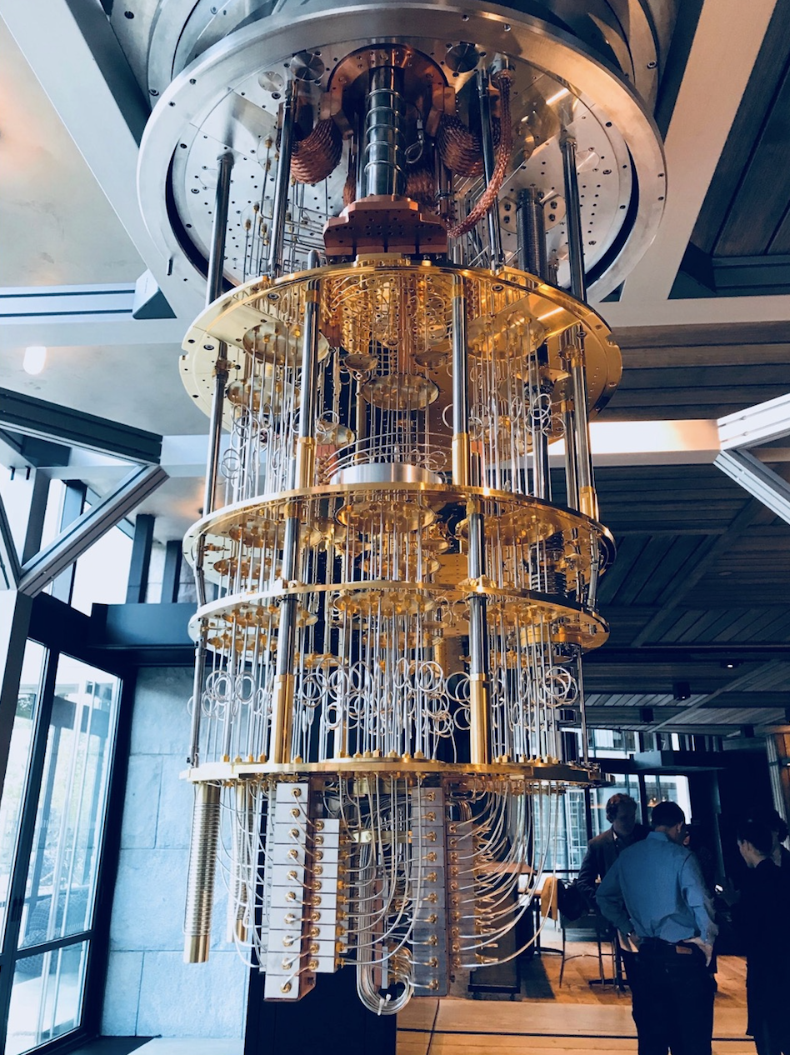
Qiskit
François Varchon
francois.varchon@fr.ibm.com
Support team for IBM Q Network

Slide 2
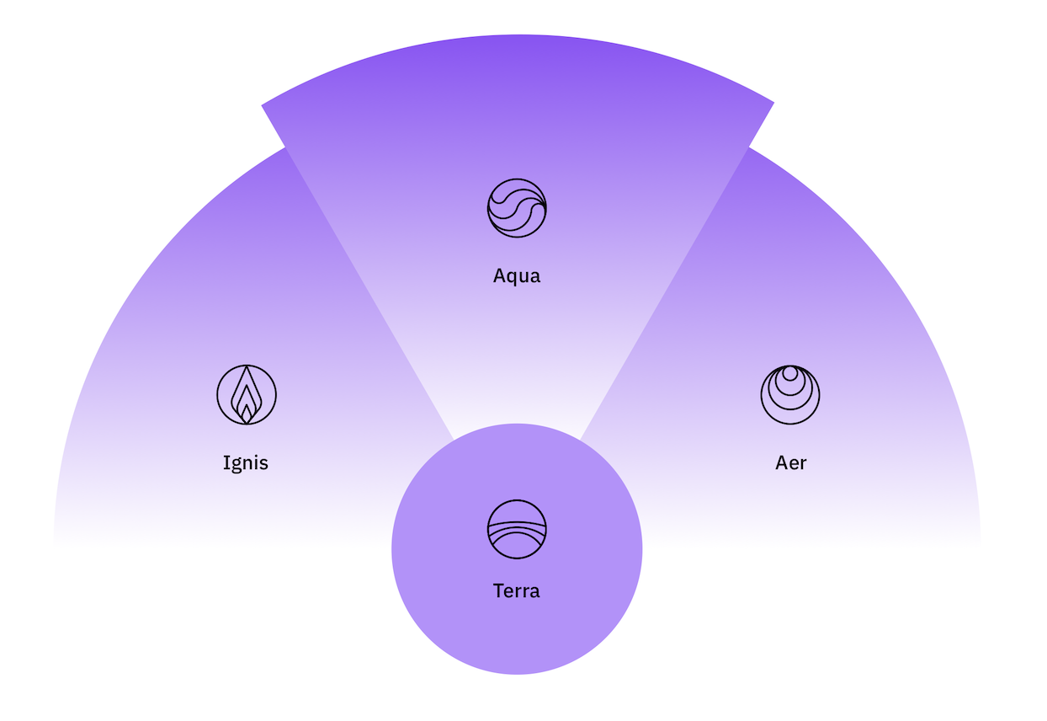
QISKIT
February 2017
Notes:
The Deutsch-Jozsa algorithm was the first to show a separation between the quantum and classical difficulty of a problem. This algorithm demonstrates the significance of allowing quantum amplitudes to take both positive and negative values, as opposed to classical probabilities that are always non-negative.
The Deutsch-Jozsa problem is defined as follows. Consider a function f(x)
that takes as input n-bit strings x and returns 0 or 1. Suppose we are promised that f(x) is either a constant function that takes the same value c∈{0,1} on all inputs x, or a balanced function that takes each value 0 and 1 on exactly half of the inputs. The goal is to decide whether f is constant or balanced by making as few function evaluations as possible. Classically, it requires 2n−1+1 function evaluations in the worst case. Using the Deutsch-Jozsa algorithm, the question can be answered with just one function evaluation. In the quantum world the function f is specified by an oracle circuit Uf (see the previous section on Grover’s algorithm, such that Uf|x⟩=(−1)f(x)|x⟩
).

Slide 3
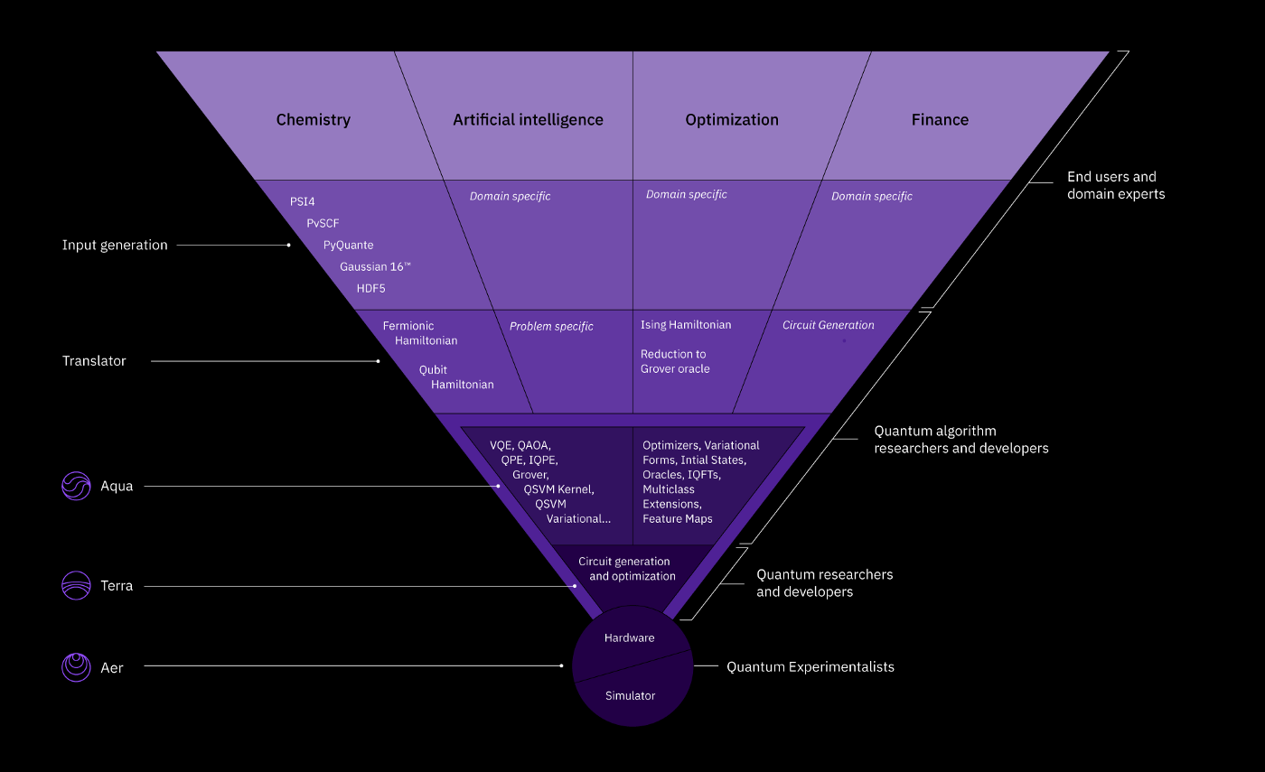
February 2017
Notes:
The Deutsch-Jozsa algorithm was the first to show a separation between the quantum and classical difficulty of a problem. This algorithm demonstrates the significance of allowing quantum amplitudes to take both positive and negative values, as opposed to classical probabilities that are always non-negative.
The Deutsch-Jozsa problem is defined as follows. Consider a function f(x)
that takes as input n-bit strings x and returns 0 or 1. Suppose we are promised that f(x) is either a constant function that takes the same value c∈{0,1} on all inputs x, or a balanced function that takes each value 0 and 1 on exactly half of the inputs. The goal is to decide whether f is constant or balanced by making as few function evaluations as possible. Classically, it requires 2n−1+1 function evaluations in the worst case. Using the Deutsch-Jozsa algorithm, the question can be answered with just one function evaluation. In the quantum world the function f is specified by an oracle circuit Uf (see the previous section on Grover’s algorithm, such that Uf|x⟩=(−1)f(x)|x⟩
).

Slide 4
February 2017
Notes:
The Deutsch-Jozsa algorithm was the first to show a separation between the quantum and classical difficulty of a problem. This algorithm demonstrates the significance of allowing quantum amplitudes to take both positive and negative values, as opposed to classical probabilities that are always non-negative.
The Deutsch-Jozsa problem is defined as follows. Consider a function f(x)
that takes as input n-bit strings x and returns 0 or 1. Suppose we are promised that f(x) is either a constant function that takes the same value c∈{0,1} on all inputs x, or a balanced function that takes each value 0 and 1 on exactly half of the inputs. The goal is to decide whether f is constant or balanced by making as few function evaluations as possible. Classically, it requires 2n−1+1 function evaluations in the worst case. Using the Deutsch-Jozsa algorithm, the question can be answered with just one function evaluation. In the quantum world the function f is specified by an oracle circuit Uf (see the previous section on Grover’s algorithm, such that Uf|x⟩=(−1)f(x)|x⟩
).

Slide 5
Qiskit Aqua
François Varchon
francois.varchon@fr.ibm.com
Support team for IBM Q Network

Slide 6
February 2017
Notes:
The Deutsch-Jozsa algorithm was the first to show a separation between the quantum and classical difficulty of a problem. This algorithm demonstrates the significance of allowing quantum amplitudes to take both positive and negative values, as opposed to classical probabilities that are always non-negative.
The Deutsch-Jozsa problem is defined as follows. Consider a function f(x)
that takes as input n-bit strings x and returns 0 or 1. Suppose we are promised that f(x) is either a constant function that takes the same value c∈{0,1} on all inputs x, or a balanced function that takes each value 0 and 1 on exactly half of the inputs. The goal is to decide whether f is constant or balanced by making as few function evaluations as possible. Classically, it requires 2n−1+1 function evaluations in the worst case. Using the Deutsch-Jozsa algorithm, the question can be answered with just one function evaluation. In the quantum world the function f is specified by an oracle circuit Uf (see the previous section on Grover’s algorithm, such that Uf|x⟩=(−1)f(x)|x⟩
).

Slide 7
QISKIT AQUA
Aqua supports two types of users:
Practitioners: interested in executing Aqua as a tool to execute Quantum Algorithms.
May not be interested in details of quantum computing, such as the notions of circuits, gates and qubits.
expect from quantum computing is the gains in performance and accuracy, and the reduction in computational complexity, compared to the use of a classical algorithm.
Quantum algorithm researchers and developers: who are interested in extending Aqua with new quantum algorithms or algorithm components for more efficient and accurate computations.
February 2017
Notes:
The Deutsch-Jozsa algorithm was the first to show a separation between the quantum and classical difficulty of a problem. This algorithm demonstrates the significance of allowing quantum amplitudes to take both positive and negative values, as opposed to classical probabilities that are always non-negative.
The Deutsch-Jozsa problem is defined as follows. Consider a function f(x)
that takes as input n-bit strings x and returns 0 or 1. Suppose we are promised that f(x) is either a constant function that takes the same value c∈{0,1} on all inputs x, or a balanced function that takes each value 0 and 1 on exactly half of the inputs. The goal is to decide whether f is constant or balanced by making as few function evaluations as possible. Classically, it requires 2n−1+1 function evaluations in the worst case. Using the Deutsch-Jozsa algorithm, the question can be answered with just one function evaluation. In the quantum world the function f is specified by an oracle circuit Uf (see the previous section on Grover’s algorithm, such that Uf|x⟩=(−1)f(x)|x⟩
).

Slide 8
QISKIT AQUA
Aqua is the only end-to-end, cross-domain quantum software stack that allows for mapping high-level classical computational software problems all the way down to a quantum machine (a simulator or a real quantum device).
Modularity and Extensibility : Aqua is a library of quantum algorithms specifically designed in order to be modular and extensible at multiple levels. → different levels of experience and scientific interests
Input Generation: allows for classical computational software to be used as the quantum application front end → extensible; new computational software can be easily plugged in
Input Translation: data obtained from the classical execution of the computational software are combined to form the input to the quantum system. → extensible (Practionners)
Quantum Algorithms: can experiment with the algorithms already included in Aqua, or contribute their own algorithms via the pluggable interface exposed by Aqua. (Researcher & Dev)
Other Key elements: Functionality, User Experience, Configuration Correctness
February 2017
Notes:
The Deutsch-Jozsa algorithm was the first to show a separation between the quantum and classical difficulty of a problem. This algorithm demonstrates the significance of allowing quantum amplitudes to take both positive and negative values, as opposed to classical probabilities that are always non-negative.
The Deutsch-Jozsa problem is defined as follows. Consider a function f(x)
that takes as input n-bit strings x and returns 0 or 1. Suppose we are promised that f(x) is either a constant function that takes the same value c∈{0,1} on all inputs x, or a balanced function that takes each value 0 and 1 on exactly half of the inputs. The goal is to decide whether f is constant or balanced by making as few function evaluations as possible. Classically, it requires 2n−1+1 function evaluations in the worst case. Using the Deutsch-Jozsa algorithm, the question can be answered with just one function evaluation. In the quantum world the function f is specified by an oracle circuit Uf (see the previous section on Grover’s algorithm, such that Uf|x⟩=(−1)f(x)|x⟩
).

Slide 9
Qiskit Aqua: Algorithms and Applications
Chemistry
Ground State Energy Dipole Moment Excited States
Finance
Portfolio Optimization
Risk Analysis Pricing
AI
Training Classification
Optimization 3SAT
MaxCut
TSP
Graph Partition
Stableset
Clique
Exact Cover
Set Packing
Vertex Cover
Quantum Algorithms
VQE
QAOA
Dynamics
QPE/IQPE
Amplitude Estimation
Grover
SVM Q Kernel
SVM Variational
Simon
Deutsch-Josza
Bernstein-Varizani HHL
February 2017
Notes:
The Deutsch-Jozsa algorithm was the first to show a separation between the quantum and classical difficulty of a problem. This algorithm demonstrates the significance of allowing quantum amplitudes to take both positive and negative values, as opposed to classical probabilities that are always non-negative.
The Deutsch-Jozsa problem is defined as follows. Consider a function f(x)
that takes as input n-bit strings x and returns 0 or 1. Suppose we are promised that f(x) is either a constant function that takes the same value c∈{0,1} on all inputs x, or a balanced function that takes each value 0 and 1 on exactly half of the inputs. The goal is to decide whether f is constant or balanced by making as few function evaluations as possible. Classically, it requires 2n−1+1 function evaluations in the worst case. Using the Deutsch-Jozsa algorithm, the question can be answered with just one function evaluation. In the quantum world the function f is specified by an oracle circuit Uf (see the previous section on Grover’s algorithm, such that Uf|x⟩=(−1)f(x)|x⟩
).

Slide 10
Modularity and Extensibility of the Aqua Library
Initial
State
Variational Form
Optimizer
VQE
Multiclass Classifier
Feature Map
QSVM Kernel
Initial
State
Variational Form
Optimizer
VQKE
Initial
State
Variational Form
Optimizer
Multiclass Classifier
Feature Map
QSVM Variational
Initial State
Optimizer
QAOA
Initial
State
Phase Estimation Circuit
Quantum Fourier Transform
Phase Estimation
Oracle
Grover
Initial
State
Phase Estimation Circuit
Quantum Fourier Transform
Approx. Phase Estimation
Oracle
Deutsch-Josza
Initial
State
Iterative Phase Estimation
Oracle
Bernestein-Vazirani
Initial
State
Phase Estimation Circuit
Quantum Fourier Transform
Random Distribution
Uncertainty Problem
Amplitude Estimation
Oracle
Simon
Initial
State
Phase Estimation Circuit
Quantum Fourier Transform
Reciprocals
Eigenvalues
HHL
Algorithms
Variational Quantum Eigensolver K Eigenvalue Decomposition QAOA Grover Deutsch-Josza Bernstein-Vazirani Simon SVM Q Kernel SVM Variational Phase Estimation Approximate Phase Estimation Iterative Phase Estimation Amplitude Estimation
Optimizers
Local | Global
Nelder-Mead Powell CG TNC SLSQP COBYLA SPSA L-BFGS-B P-BFGS | Direct-L Direct-L-Rand CRS2-LM ISRES ESCH
Variational Forms
RyRz Ry SwapRz UCCSD
Feature Maps
Pauli Expansion Pauli Z Expansion First Order Expansion Second Order Expansion
Random Distributions
BernoulliDistribution LogNormalDistribution MultivariateDistribution MultivariateNormalDistribution MultivariateUniformDistribution NormalDistribution UniformDistribution UnivariateDistribution
Uncertainty Problems
FixedIncomeExpectedValue, EuropeanCallExpectedValue EuropeanCallDelta
Qubit Mappings
Jordan-Wigner Parity Braviy-Kitaev Bravyi-Kitaev Super Fast
Initial States
Zero HartreeFock Custom
Multiclass Extensions
All Pairs One Against All Error-correcting Code
Oracles
Logic Expression Oracle Truth Table Oracle
Chemistry Drivers
Gaussian PSI4 PySCF PyQuante HDF5
QFTs/IQFTs
Standard Approximate
Eigenvalues
Eigenvalues for QPE
Reciprocals
Long Division Lookup Rotation

Slide 11
How to Get the Code and Contribute
https://github.com/Qiskit/qiskit-aqua (pip install or clone)
Algorithms
AI
Optimization
Finance
https://github.com/Qiskit/qiskit-chemistry (pip install or clone)
Chemistry
https://github.com/Qiskit/qiskit-tutorials (clone)
Algorithms
AI
Chemistry
Optimization
Finance
https://qiskit.org/aqua
February 2017
Notes:
The Deutsch-Jozsa algorithm was the first to show a separation between the quantum and classical difficulty of a problem. This algorithm demonstrates the significance of allowing quantum amplitudes to take both positive and negative values, as opposed to classical probabilities that are always non-negative.
The Deutsch-Jozsa problem is defined as follows. Consider a function f(x)
that takes as input n-bit strings x and returns 0 or 1. Suppose we are promised that f(x) is either a constant function that takes the same value c∈{0,1} on all inputs x, or a balanced function that takes each value 0 and 1 on exactly half of the inputs. The goal is to decide whether f is constant or balanced by making as few function evaluations as possible. Classically, it requires 2n−1+1 function evaluations in the worst case. Using the Deutsch-Jozsa algorithm, the question can be answered with just one function evaluation. In the quantum world the function f is specified by an oracle circuit Uf (see the previous section on Grover’s algorithm, such that Uf|x⟩=(−1)f(x)|x⟩
).

Slide 12
Qiskit Aer
François Varchon
francois.varchon@fr.ibm.com
Support team for IBM Q Network

Slide 13
February 2017
Notes:
The Deutsch-Jozsa algorithm was the first to show a separation between the quantum and classical difficulty of a problem. This algorithm demonstrates the significance of allowing quantum amplitudes to take both positive and negative values, as opposed to classical probabilities that are always non-negative.
The Deutsch-Jozsa problem is defined as follows. Consider a function f(x)
that takes as input n-bit strings x and returns 0 or 1. Suppose we are promised that f(x) is either a constant function that takes the same value c∈{0,1} on all inputs x, or a balanced function that takes each value 0 and 1 on exactly half of the inputs. The goal is to decide whether f is constant or balanced by making as few function evaluations as possible. Classically, it requires 2n−1+1 function evaluations in the worst case. Using the Deutsch-Jozsa algorithm, the question can be answered with just one function evaluation. In the quantum world the function f is specified by an oracle circuit Uf (see the previous section on Grover’s algorithm, such that Uf|x⟩=(−1)f(x)|x⟩
).

Slide 14

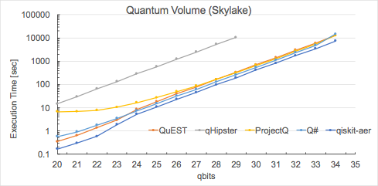
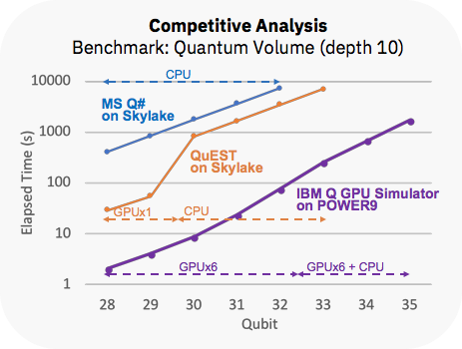
Aer
- Ultra-high performance classical simulators (CPU & GPU).
50% faster
- Multiple simulation models:
Qasm, statevector, Unitary, Clifford, Tensor-networks, Decision-diagrams (JKU).
- Configurable noise models:
Unitary, reset, and measurement errors (state independent).
Kraus noise (state dependent).
- Starting point for adding external simulators.
14

Slide 15
Openpulse
François Varchon
francois.varchon@fr.ibm.com
Support team for IBM Q Network

Slide 16
February 2017
Notes:
The Deutsch-Jozsa algorithm was the first to show a separation between the quantum and classical difficulty of a problem. This algorithm demonstrates the significance of allowing quantum amplitudes to take both positive and negative values, as opposed to classical probabilities that are always non-negative.
The Deutsch-Jozsa problem is defined as follows. Consider a function f(x)
that takes as input n-bit strings x and returns 0 or 1. Suppose we are promised that f(x) is either a constant function that takes the same value c∈{0,1} on all inputs x, or a balanced function that takes each value 0 and 1 on exactly half of the inputs. The goal is to decide whether f is constant or balanced by making as few function evaluations as possible. Classically, it requires 2n−1+1 function evaluations in the worst case. Using the Deutsch-Jozsa algorithm, the question can be answered with just one function evaluation. In the quantum world the function f is specified by an oracle circuit Uf (see the previous section on Grover’s algorithm, such that Uf|x⟩=(−1)f(x)|x⟩
).

Slide 17
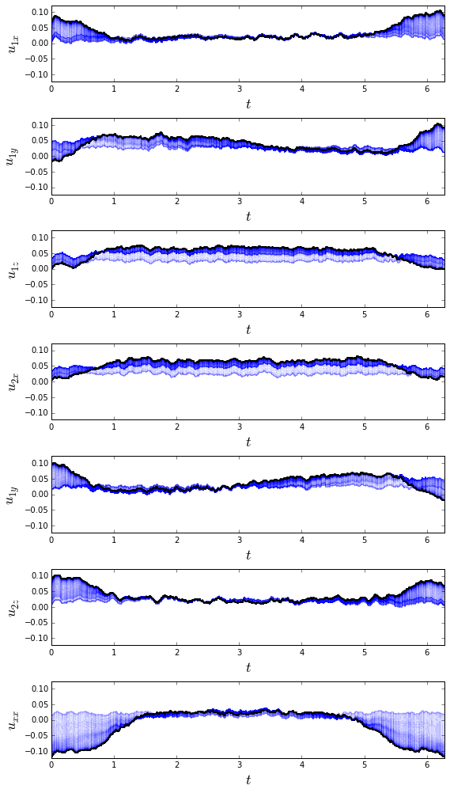
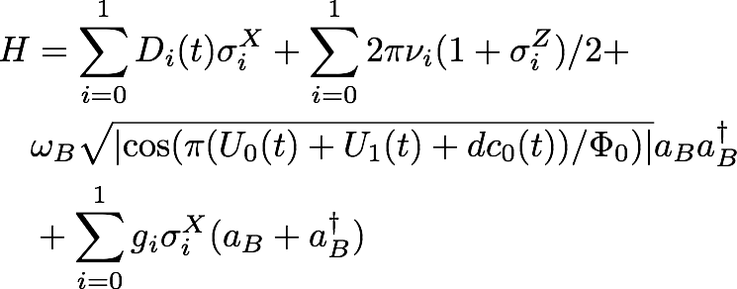
OpenPulse
- Control of IBM Q hardware at the pulse-level.
- See arXiv:1809.03452
- Unprecedented low-level access to hardware.
- User defined pulse / gate sequences:
- Optimal control.
- Dynamical decoupling.
- Hamiltonian tomography.
- Markovian noise simulator.
17

Slide 18
Additional content
February 2017
Notes:
The Deutsch-Jozsa algorithm was the first to show a separation between the quantum and classical difficulty of a problem. This algorithm demonstrates the significance of allowing quantum amplitudes to take both positive and negative values, as opposed to classical probabilities that are always non-negative.
The Deutsch-Jozsa problem is defined as follows. Consider a function f(x)
that takes as input n-bit strings x and returns 0 or 1. Suppose we are promised that f(x) is either a constant function that takes the same value c∈{0,1} on all inputs x, or a balanced function that takes each value 0 and 1 on exactly half of the inputs. The goal is to decide whether f is constant or balanced by making as few function evaluations as possible. Classically, it requires 2n−1+1 function evaluations in the worst case. Using the Deutsch-Jozsa algorithm, the question can be answered with just one function evaluation. In the quantum world the function f is specified by an oracle circuit Uf (see the previous section on Grover’s algorithm, such that Uf|x⟩=(−1)f(x)|x⟩
).

Slide 19

Qiskit Chemistry
Chemical Configuration
Two-body integrals in MO basis
Driver execution
[[[[6.73630125e-01 2.22044605e-16]
[3.05311332e-16 6.62687200e-01]]
[[2.28983499e-16 1.81541086e-01]
[1.81541086e-01 1.38777878e-16]]]
[[[1.73472348e-16 1.81541086e-01]
[1.81541086e-01 5.55111512e-17]]
[[6.62687200e-01 1.11022302e-16]
[1.11022302e-16 6.96566757e-01]]]]
Chemistry
h2 molecule
0 1
H 0.0 0.0 0.0
H 0.0 0.0 0.2
End Users and Domain Experts
Input Generation
PSI4
PySCF
PyQuante
One-body integrals in MO basis
Dipole integrals
Molecular orbital coefficients
Hartree-Fock energy
Nuclear repulsion energy
Gaussian
HDF5
Drivers
Quantum Input Generation
Driver-independent input
[[-1.24974950e+00 -4.44089210e-16]
[-2.08166817e-16 -4.78751850e-01]]
Translator
API
Qubit Operator
&HAMILTONIAN
TYPE=FULL
TRANSFORMATION_TO_SPIN=PARITY
&END
&QUANTUM_METHOD
NAME_Q_METHOD=VQE
&END
IIII -0.810547986276
ZIII 0.172183942731
ZZII -0.225753502515
IZZI 0.172183942731
IIZZ -0.225753502515
IZII 0.120912633586
ZZZI 0.168927540489
XZXI -0.045232799795
XIXZ 0.045232799795
XIXI 0.045232799795
XZXZ -0.045232799795
ZIZZ 0.166145433380
ZIZI 0.166145433380
ZZZZ 0.174643431424
IZIZ 0.120912633586
Operator
Fermionic Hamiltonian
Qubit Hamiltonian
Quantum Configuration
Domain-independent input
OpenQASM Circuit Representation
Qiskit Aqua
Final Energy
API
OPENQASM 2.0;
include "qelib1.inc";
qreg q[4];
creg c[4];
barrier q[0],q[1],q[2],q[3];
cz q[0],q[1];
cz q[0],q[2];
cz q[0],q[3];
cz q[1],q[0];
cz q[1],q[2];
cz q[1],q[3];
cz q[2],q[0];
cz q[2],q[1];
cz q[2],q[3];
cz q[2],q[3];
cz q[2],q[3];
cz q[3],q[0];
cz q[3],q[1];
cz q[3],q[2];
ry(1.602180515741816) q[0];
rz(2.101578398242260) q[0];
ry(-1.946373587370641) q[1];
rz(0.758362974519232) q[1];
ry(-0.321568447820939) q[2];
rz(0.735401474544032) q[2];
ry(-3.985472706467653) q[3];
rz(-3.621896879029687) q[3];
barrier q[0],q[1],q[2],q[3];
cz q[0],q[1];
cz q[0],q[2];
cz q[0],q[3];
cz q[1],q[0];
cz q[1],q[2];
cz q[1],q[3];
cz q[2],q[0];
cz q[2],q[1];
cz q[2],q[3];
cz q[2],q[3];
cz q[2],q[3];
cz q[3],q[0];
cz q[3],q[1];
cz q[3],q[2];
ry(-1.956365394733121) q[0];
rz(2.782434917882929) q[0];
ry(2.165512585508974) q[1];
rz(-2.665809160889736) q[1];
ry(2.904098438162670) q[2];
rz(-1.120689215841314) q[2];
ry(5.094050467440653) q[3];
rz(-2.615735023496133) q[3];
barrier q[0],q[1],q[2],q[3];
Algorithm Researchers and Developers
Consecutive identical CZ gates optimized out by the Qiskit Transpiler
VQE
QAOA
Dynamics
QPE/IQPE
Amplitude Estimation
Grover
SVM Q Kernel
SVM Variational
Simon
Deutsch-Josza
Bernstein-Varizani
HHL
0.16473420637865788
Algorithms
Optimizers
Var Forms Initial States
Oracles QFTs/IQFTs
Multiclass Ext
Feature Maps Random Dist.
Uncert. Probl.
Reciprocals
Eigenvalues
Ground-state Molecular Energy
Dipole Moment
Excited States
Quantum Researchers and Developers
Quantum Computation
Terra
API
Quantum Experimentalists
Hardware
Simulator

Slide 20
Qiskit Artificial Intelligence
Qiskit Optimization
Algorithms:
SVM Q Kernel
SVM Variational
Problems being solved:
Training
Classification
Algorithms:
Grover
VQE
QAOA
Problems being solved:
3SAT
MaxCut
TSP
Graph partition
Stableset
Clique
Exact cover
Set packing
Vertex cover
Qiskit Finance
Algorithms:
Amplitude Estimation
VQE
QAOA
Problems being solved:
Risk Analysis
Pricing
Portfolio Optimization

Slide 21





The Aqua Team
Marco Pistoia
Richard Chen
Shaohan Hu
Peng Liu
Manoel Marques
Steve Wood

